Slide 1
Lec -10
Unit –II
PHYSICAL LAYER:
( (Transmission Impairments and Performance, Transmission media like Guided and Unguided media , Cabling standards))

Slide 2
What is Transmission media and Transmission Impairments and Performance ?
A transmission medium can be broadly defined as anything that can carry information from a source to a destination.
For example, the transmission medium for two people having a dinner conversation is the air.

Slide 3
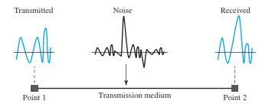
What is Transmission Impairment ?
Transmission impairment is defined as it occurs when the received signal is different from the transmitted signal. As we know, a signal can be transmitted as Analog signal or it can be transmitted as a digital signal that is called a transmission impairment .
Reasons for Transmission impairment .
Signal transmit through medium that are not perfect.
This imperfection cause signal impairment.

Slide 4
Causes of impairment.

Slide 5
What is Attenuation ?
Attenuation –
Means loss of energy->weaker signal .
When a signal travels through a medium Loses energy overcoming the resistance of the medium.
Amplifiers are used to compensate for this loss of energy by amplifying the signal.

Slide 6
Measurement of Attenuation .
To show the loss or gain of energy the unit “decibel” is used.
dB = 10log10P2/P1
P1-input signal
P2-output signal.

Slide 7
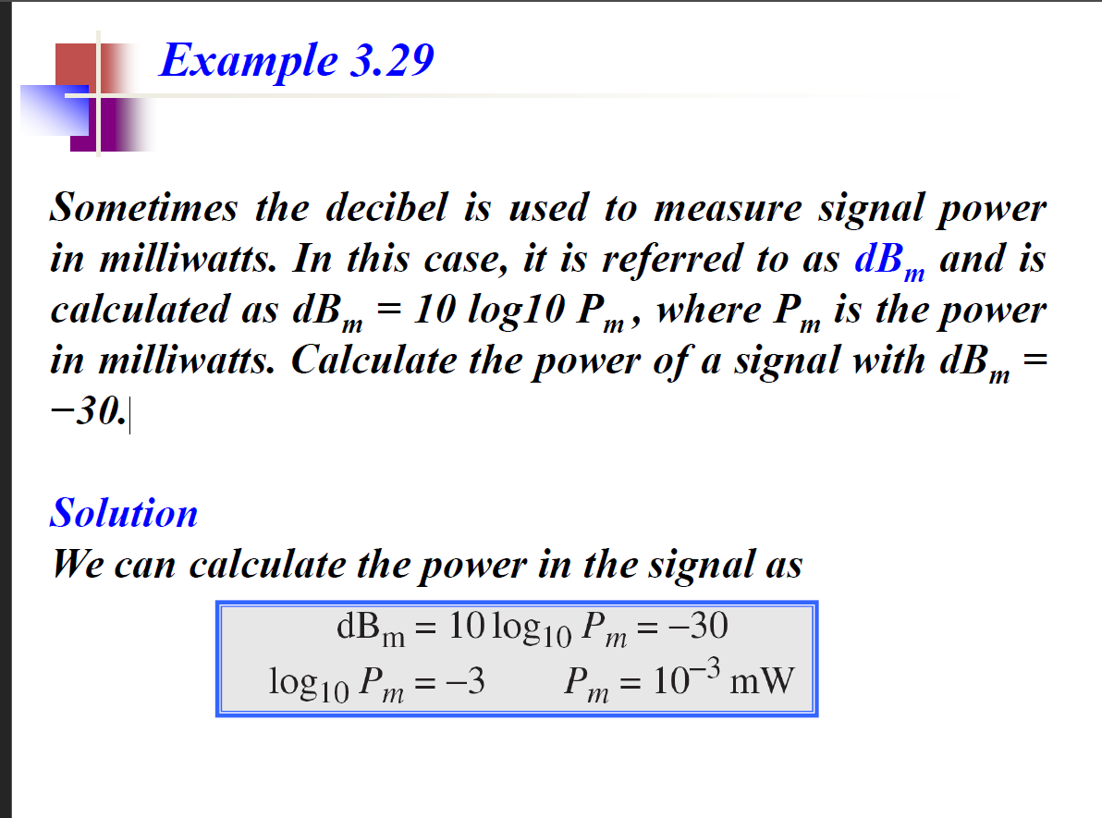
Example of Attenuation .

Slide 8
Distortion.
Distortion is defined as when the signal can change its form or shape.
It can occur in a composite signal made of different frequencies. Each signal component has its own propagation speed through a medium and, therefore, its own delay in arriving at the final destination.
Or
Distortion describes an interruption of transmitting signals that cause an unclear reception.

Slide 9
Distortion.

Slide 10
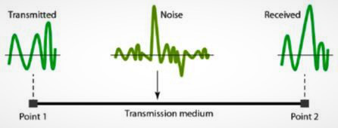
What is Noise Impairment?
Noise Impairment occurs when an unwanted signal is inserted between transmission and reception.

Slide 11
Types of Noise Impairment?
Noise is another cause of impairment.
Several types of noise, such as thermal noise, induced noise, crosstalk, and impulse noise, may corrupt the signal.
Thermal noise is the random motion of electrons in a wire, which creates an extra signal not originally sent by the transmitter.
Induced noise comes from sources such as motors and appliances. These devices act as a sending antenna, and the transmission medium acts as the receiving antenna.
Crosstalk is the effect of one wire on the other. One wire acts as a sending antenna and the other as the receiving antenna.
Impulse noise is a spike (a signal with high energy in a very short time) that comes from power lines, lightning, and so on .

Slide 12
Transmission Impairments and Performance .
Performance
Performance refers to measures of service quality of a network as seen by the customer.
Also, it is the analysis and review of collective network statistics, to define the quality of services offered by the underlying computer network.
It is a qualitative and quantitative process that measures and defines the performance level of a given network. There are many different ways to measure the performance of a network, as each network is different in nature and design

Slide 13
Types of measures to check performance.
Bandwidth One characteristic that measures network performance is bandwidth. However, the term can be used in two different contexts with two different measuring values: bandwidth in hertz and bandwidth in bits per second.
Bandwidth in Hertz -It is the range of frequencies contained in a composite signal or the range of frequencies a channel can pass.
For example, we can say the bandwidth of a subscriber telephone line is 4 kHz.
Bandwidth in Bits per Seconds -The term bandwidth can also refer to the number of bits per second (speed of bit) transmission in a channel or link.
For example, one can say the bandwidth of a Fast Ethernet network (or the links in this network) is a maximum of 100 Mbps. This means that this network can send 100 Mbps

Slide 14
What is Throughput and Network latency ?
Throughput
The throughput is a measure of how fast we can actually send data through a network.
Latency (Delay) –
Network latency is the amount of time it takes for a data packet to go from one place to another.
The latency or delay defines how long it takes for an entire message to completely arrive at the destination from the time the first bit is sent out from the source.

Slide 15
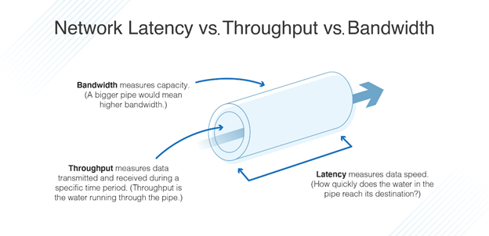
Difference between latency , Throught put and Bandwidth.

Slide 16
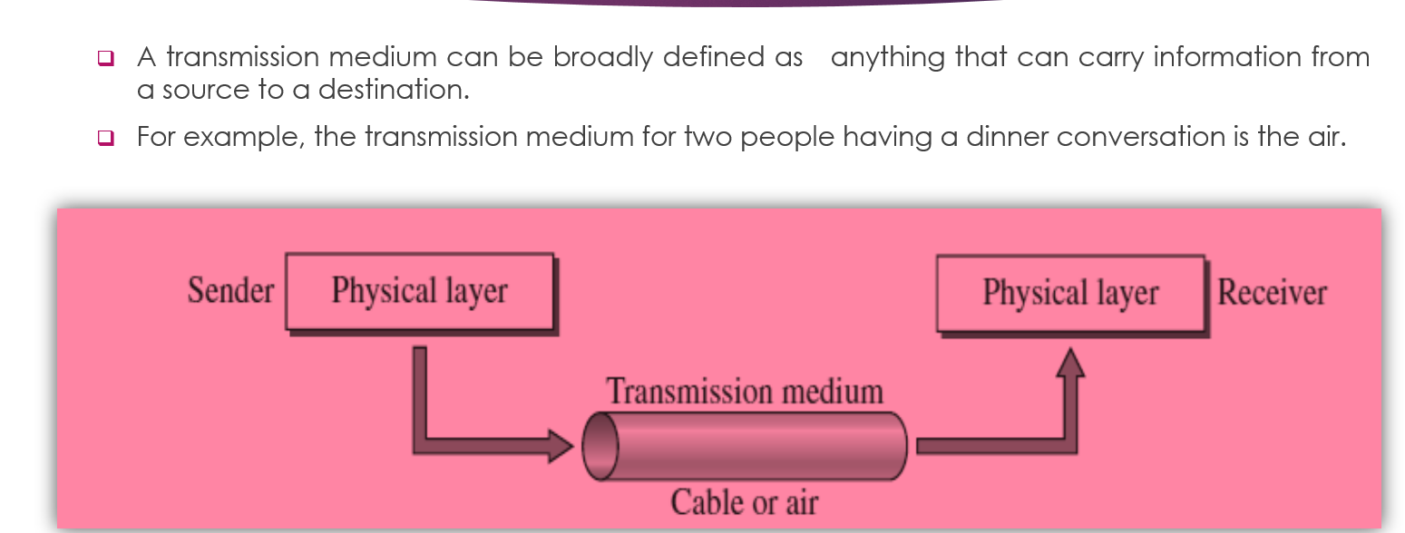
What is Transmission Media ?

Slide 17
Types of Transmission media .

Slide 18
Twisted-Pair Cable.
Twisted Pair and Coax use metallic(Copper) conductors that accept and transport the signals in the form of Electrical Current.

Slide 19
UTP and STP cables .

Slide 20
Shielded Twisted-Pair Cable . •
A shielded twisted pair is a type of cable that contains the mesh surrounding the wire that allows the higher
transmission rate.

Slide 21
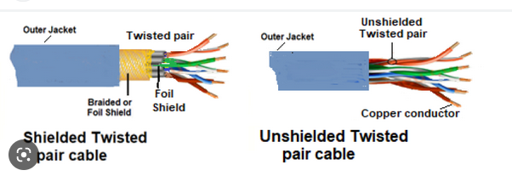
Difference between Shielded and Unshielded Twisted pair cable .

Slide 22
What are Advantages and disadvantages of STP ?
Advantages of STP.
1. Cheaper
2. Less susceptible to electrical interference caused by nearby equipment or wires.
3. In turn are less likely to cause interference themselves.
4. Because it is electrically "cleaner", STP wire can carry data at a faster speed.
Disadvantages :
1. STP wire is that it is physically larger and more expensive than twisted pair wire.

Slide 23
Unshielded Twisted pair cable .

Slide 24
Unshielded Twisted pair cable.
An unshielded twisted pair is widely used in telecommunication.
Category 1: Category 1 is used for telephone lines that have low-speed data.
Category 2: It can support upto 4Mbps.
Category 3: It can support upto 16Mbps.
Category 4: It can support upto 20Mbps. Therefore, it can be used for long-distance communication.
Category 5: It can support upto 200Mbps.

Slide 25
Coaxial cable .

Slide 26
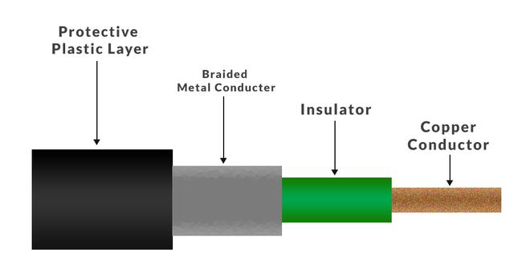
Structure of coaxial cable .

Slide 27
Standard cable Types of Coaxial cable.

Slide 28
What is coaxial cable ?
A coaxial cable is define as the type of shielded and insulated copper cable which is used in computer networks and provide the cable TV services to end users.
It was firstly designed in the early 1940s and is used for both baseband and broadband data communication services.
Types of coaxial cable.
What is baseband and broadband coaxial cable?
A baseband is a type of coaxial cable which transmits a single signal at a time at very high speed.
A broadband is a type of coaxial cable can transmit many simultaneous signals using different frequencies.

Slide 29
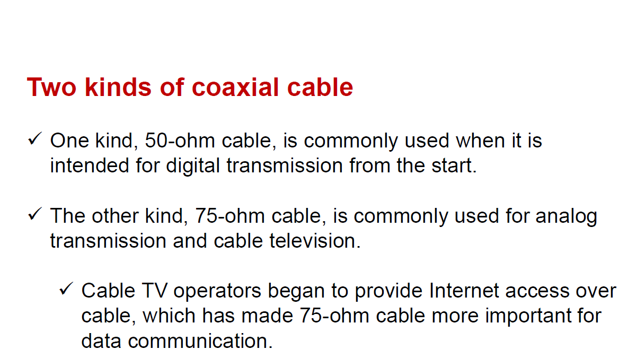
Types of coaxial cable .

Slide 30
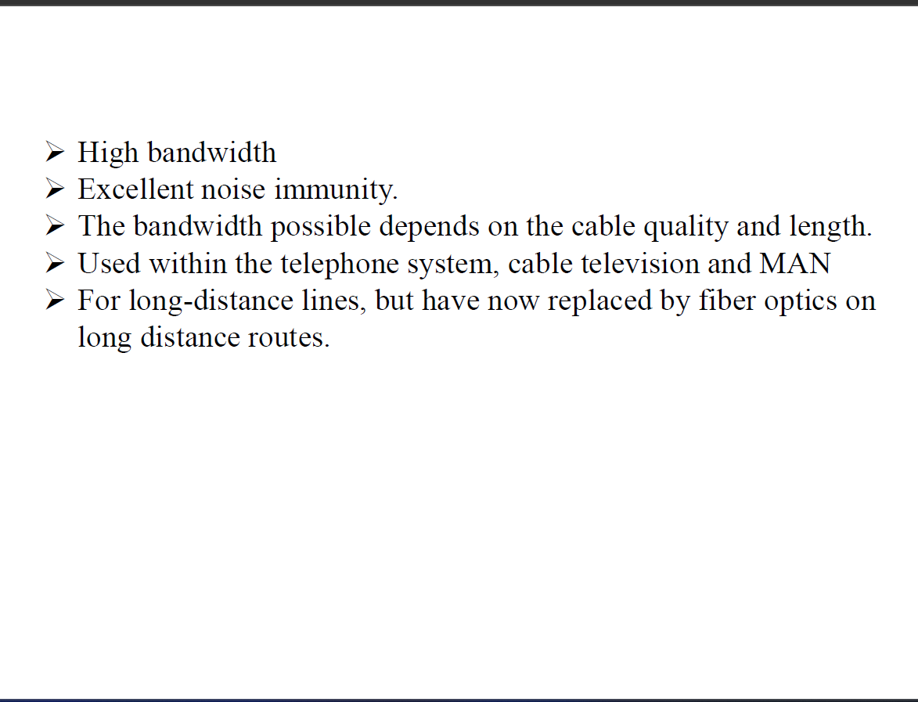
Advantages of coaxial cable .

Slide 31
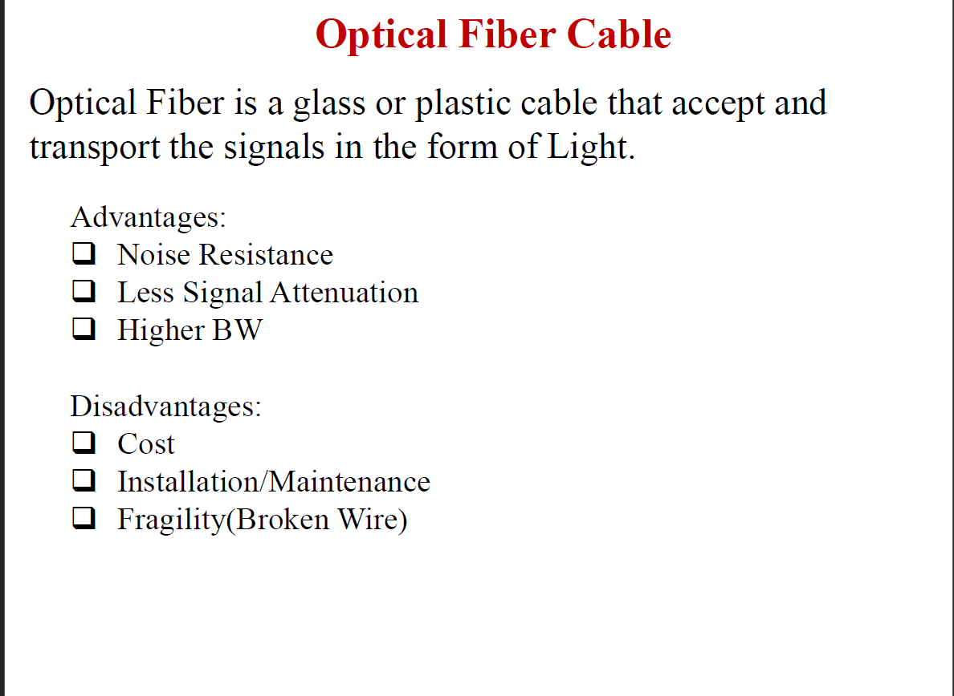
What is optical fiber cable ?

Slide 32
What is optical fiber cable ?

Slide 33
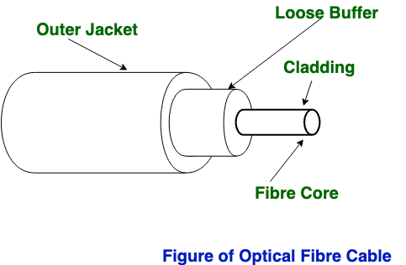
Optical fiber cable .
Fiber Optics is made up of a thin flexible fibers of glass or other transparent solids to transmit light signals which is used in telecommunications .
Fiber-optic cables is used for transmit data via fast-traveling pulses of light.

Slide 34
What is Unguided Media ?
Unguided media is a type of wireless communication which provides flexible communication by uses signals such as radio waves, microwaves, infrared and satellite communication.

Slide 35
What is Microwave transmission ?
Microwave transmission- It comprises of an electromagnetic wave having a range of frequencies approximately (1-300GHz).
Microwaves travel in straight lines and therefore the narrow focus concentrates all the energy into a beam.
In microwaves periodic repeaters are necessary for long distances and for transmitting and receiving antennas are aligned accurately.
Example − Bluetooth technology.

Slide 36
Unidirectional antennas .
Microwaves are used for unicast communication such as cellular telephones and wireless LANs. Higher frequency ranges cannot penetrate walls . Use directional antennas -point to point line of sight communications.

Slide 37
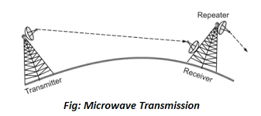
Function of directional antennas.

Slide 38
Radio waves.
Radio waves are used for multicast communications, such as radio and television . They can penetrate through walls . Use Omni directional antennas .
The radio waves are the low-frequency electromagnetic wave ranging from ‘3 kHz to 1GHz’. As the radio waves are having the low-frequency waves, they can penetrate walls and you can receive signals even if you are inside the building. The radio waves are also called a omnidirectional which means that the source transmitter transmits the radio wave in the sky and they are reflected from the sky and received by the receiving antenna.

Slide 39
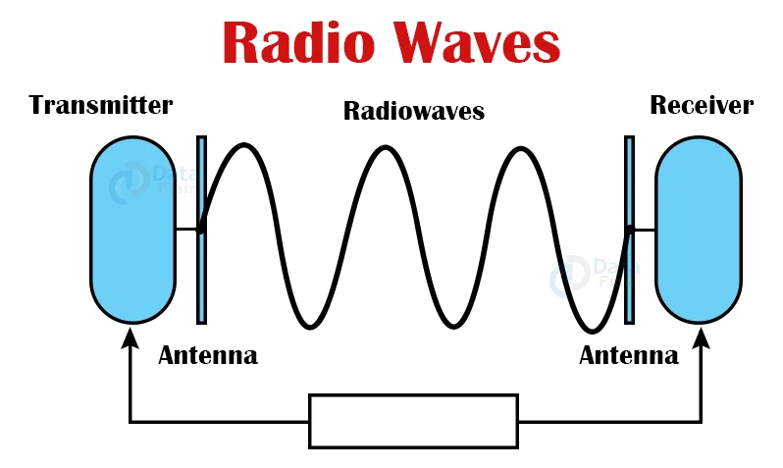
Radio Waves.

Slide 40
What is infrared Transmission ?
Infrared signals can be used for short-range communication in a closed area using line-of-sight propagation.
Infrared is used in wireless technology devices or systems that convey data through infrared radiation.
Infrared wireless is used for medium and short range .
Example of Infrared transmission
Remote Control. The remote controls that are used to control the operation of certain
gadgets such as televisions, stereos, toy cars, etc.

Slide 41
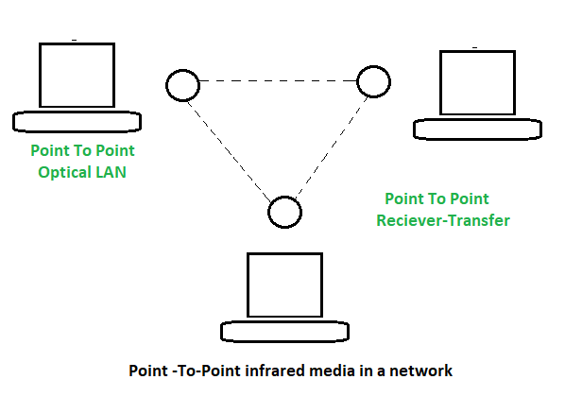
infrared Transmission .

Slide 42
Cabling standards.
What is the purpose of cabling standards?
The main function of Cable standards are providing a set of requirements, recommendations, and procedures for the design, manufacture, testing, and installation of cables which is used in networks .
Coaxial cable Standards

Slide 43
Advantages of Optic Fiber cables .
FIBER OPTIC CABLE ADVANTAGES OVER COPPER:
SPEED: Fiber optic networks operate at high speeds - up into the gigabits
BANDWIDTH: large carrying capacity
DISTANCE: Signals can be transmitted further without needing to be "refreshed" or strengthened.
RESISTANCE: Greater resistance to electromagnetic noise such as radios, motors or other nearby cables.
MAINTENANCE: Fiber optic cables costs much less to maintain.

Slide 44
Types of optic Fiber cables.
There are three types of fiber optic cable: single mode, multimode and plastic optical fiber (POF).
Single-mode fiber – It gives you a higher transmission rate and up to 50 times more distance than multimode, but it also costs more. Single-mode fiber has a much smaller core than multimode fiber-typically 5 to 10 microns.
Multimode fiber gives you high bandwidth at high speeds over long distances. Light waves are dispersed into numerous paths, or modes, as they travel through the cable's core.
POF is a newer plastic-based cable which promises performance similar to single mode cable, but at a lower cost.

Slide 45


